Slide 1

Quickwrite
What do you know about plotting points on a graph.
You have 2 minutes to write all you can remember
Notes:
Give them time to write what they know on the left hand side.
How you get the info off them is up to you, TPS, popcorn etc.

Slide 2
24
7
30
Date
Cartesian plane
EQ – How can we plot points on the Cartesian plane?
5
Notes:
Lesson objective (EQ)

Slide 3
Lesson objective
By the end of this lesson you will be able to;
Identify the four quadrants in the Cartesian plane
Plot and identify points on the Cartesian Plane
Notes:
Lesson

Slide 4
Success Criteria
You will know you are successful in achieving the objective by…
- Plot points on the Cartesian plane

Slide 5
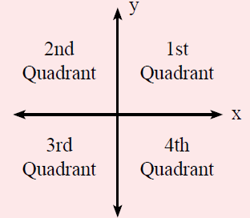

24
7
30
Date
Cartesian Plane
EQ- How can we plot points on the Cartesian plane?
What are the four quadrants?
$$Coordinates are \left(x,y\right)$$
5
Notes:
Input

Slide 6
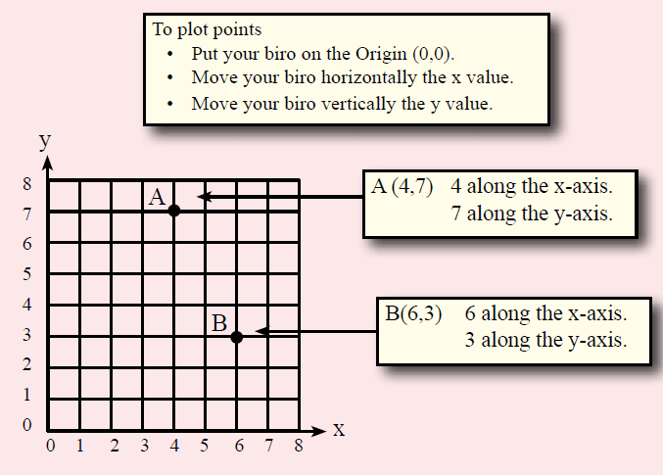
24
7
30
Date
Cartesian Plane
EQ- How can we plot points on the Cartesian plane?
How do you plot points on the cartesian plane?
5
Notes:
Input

Slide 7
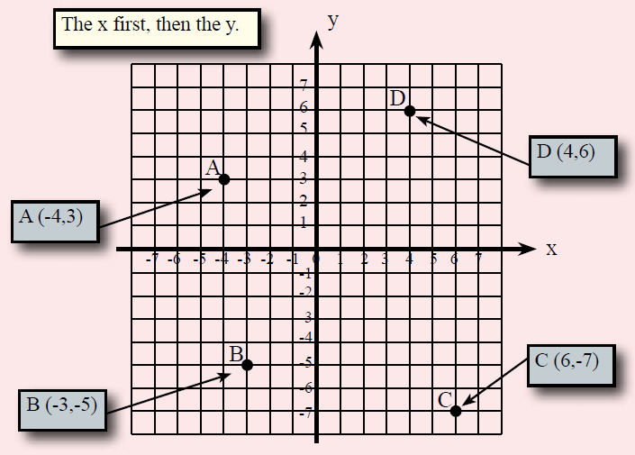
What are the Coordinates?
Notes:
Check for understanding

Slide 8

Complete the practice sheet
REMEMBER X-axis first (horizontal)
Notes:
They will be plotting points to draw a picture of a Kangaroo

Slide 9
